Slide 1

Effect of Leading and Trailing Edge Flaps on Flat Plates at Low Reynold’s Numbers
Cory Coffman and Dr. Lance Traub
Embry-Riddle Aeronautical University, Prescott, AZ, USA

Slide 2
Acknowledgments
Patrick M. David, Machinist
Dr. Kenneth Bordignon, Professor

Slide 3
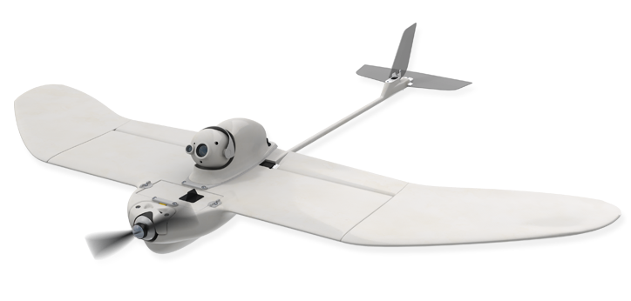
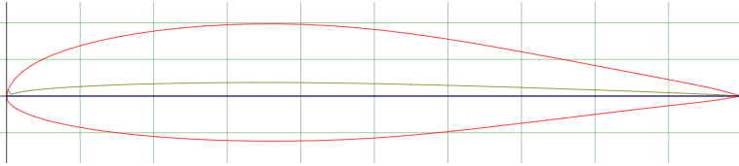
Motivation
Poor Airfoil Performance at Low Reynold;s numbers (Re)
Micro Aerial Vehicles (MAVs)
S8036 Low Re Airfoil. Digital Image. Airfoil Tools. 2019
RQ-12A Wasp. Digital Image. Aerovironment. 2019

Slide 4
Objective
Determine an optimum configuration of flap settings
  Deflection angle and % chord
Compare performance to existing airfoils (S8036, SD 7062, NACA 0015, circular arc)
  Arc is supposed to be best
  No research for flapped flat plates

Slide 5
Construction
Airfoils hydrocut from 1/32” 6061-T6 aluminum
Flaps bent in using sheet metal brake
  Flap angles set at 10, 15, 20, and 25 degrees
  Flap size set at 10, 15, and 20 percent of chord
  One circular arc with height of 5% chord also manufactured

Slide 6
Methodology
Testing completed at Nancy and Tracy Doryland Wind Tunnel at ERAU
Trailing edge (TE) flaps tested to find optimum angle
Leading edge (LE) flaps added, optimum configuration of LE and TE is found
Optimum configuration is compared against the 5% arc and airfoils
Off-surface and on-surface flow visualization performed
Pressure readings for upper and lower surface taken

Slide 7
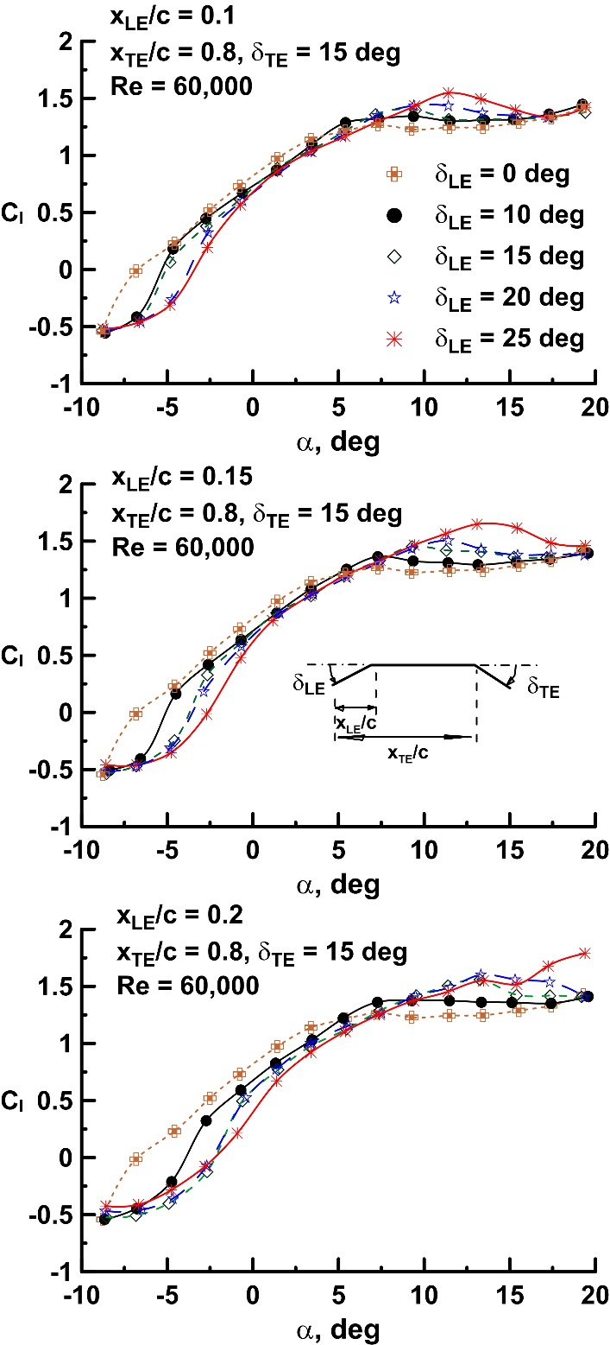
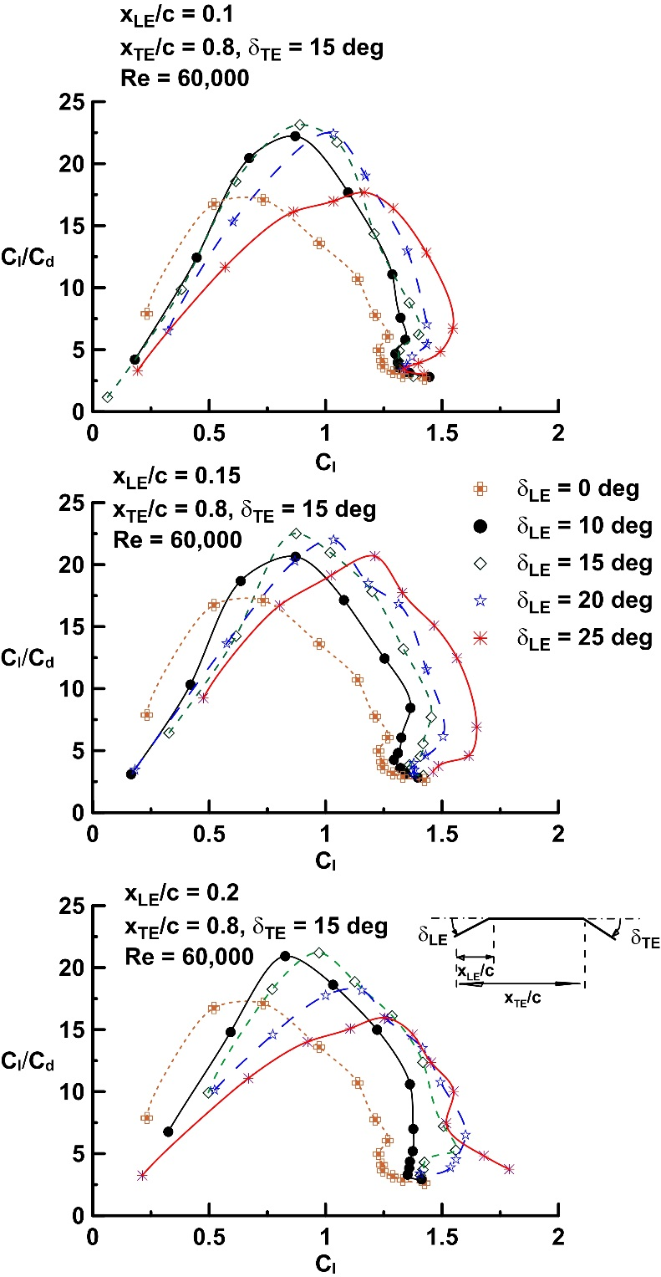
Results (1/2)
Lift Coefficient as a Function of Alpha
Lift-to-Drag Ratio as a Function of Cl
Optimum TE configuration is 20% C, 15 degrees
Optimum LE configuration is 10% C, 15 degrees

Slide 8
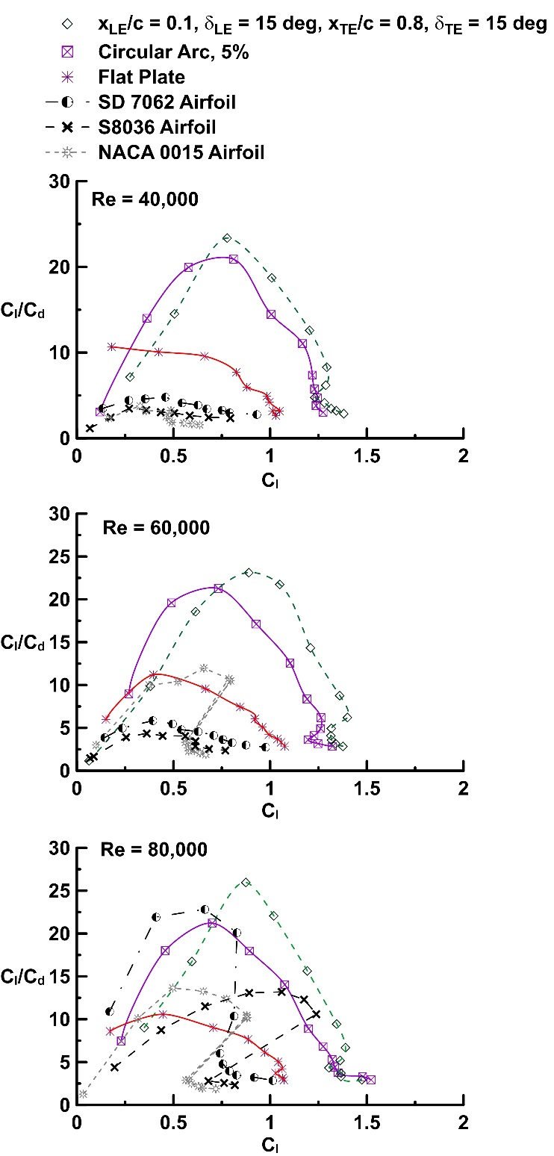
Results (2/2)
Lift-to-Drag Ratio as a Function of Cl
Flapped flat plate outperforms all others in these Re ranges
106% increase in Cl/Cd with flaps over unflapped flat plate

Slide 9
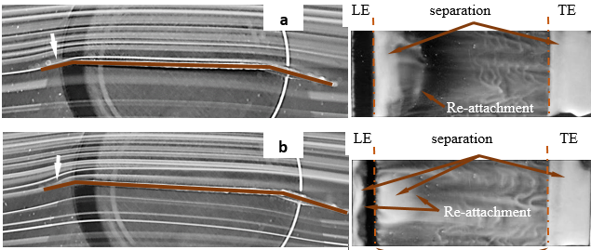

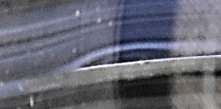
Flow Visualization
α = 1.5 deg (peak Cl/Cd)
High L/D correlates with smooth on flow
α = 3 deg
α = 1.5 deg
α = 1.5 deg
α = 3 deg (detail)

Slide 10
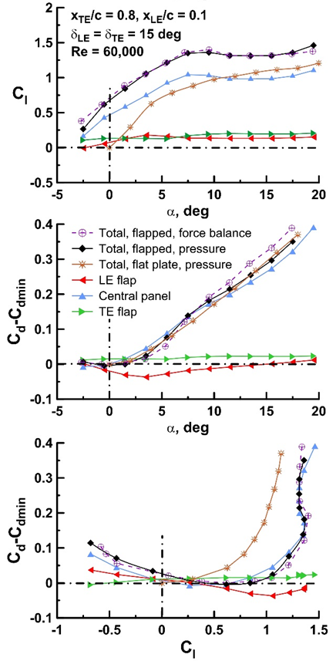
Pressure Tappings
Pressure coefficient across upper and lower surface integrated to verify Cl and Cd
Force balance and pressure tappings offer good agreement

Slide 11
Summary
Flapped flat plates readily outperform conventional airfoils at low Reynolds numbers
High efficiency correlates with:
  Smooth on-flow onto the flap LE
  Presence of a laminar separation bubble
  Flap promoting transition to turbulent boundary layer
Future Development
  Implementation and systems integration on MAVs
  Varying angle geometry on MAVs for different flight regimes

